Slide 1
National Committee on Foreign Medical Education and Accreditation (NCFMEA)
2020 Guidelines Revision
Office of Postsecondary Education
U.S. Department of Education

Slide 2
Updated Guidelines - 2020
The NCFMEA Guidelines for Determination of Comparability were revised in September, 2020 and were effective on September 1, 2021.
The purpose of this presentation is to:
highlight changes and revisions; and
insert report submission requirements for clarity.

Slide 3
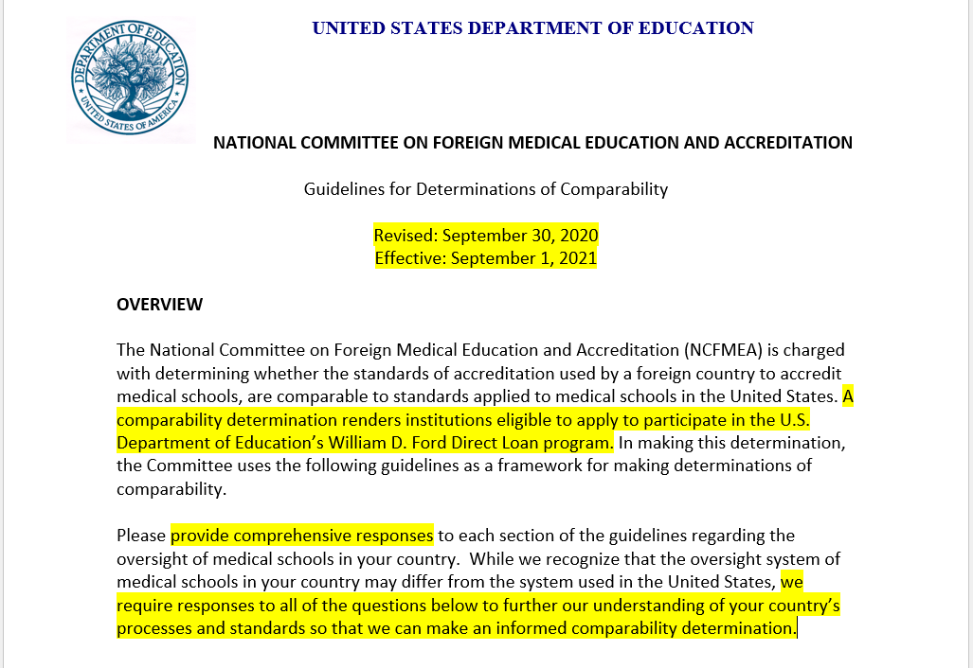
Overview
Notes:
The purpose of the NCFMEA guidelines is to determine a foreign medical institution’s comparability to medical education in the United States which allows the students of those foreign institutions to participate in the U.S. Department of Education’s William D. Ford Direct Loan Program. These guidelines were last revised in 2017 and the current version was revised in 2020 and became effective on September 1, 2021.

Slide 4
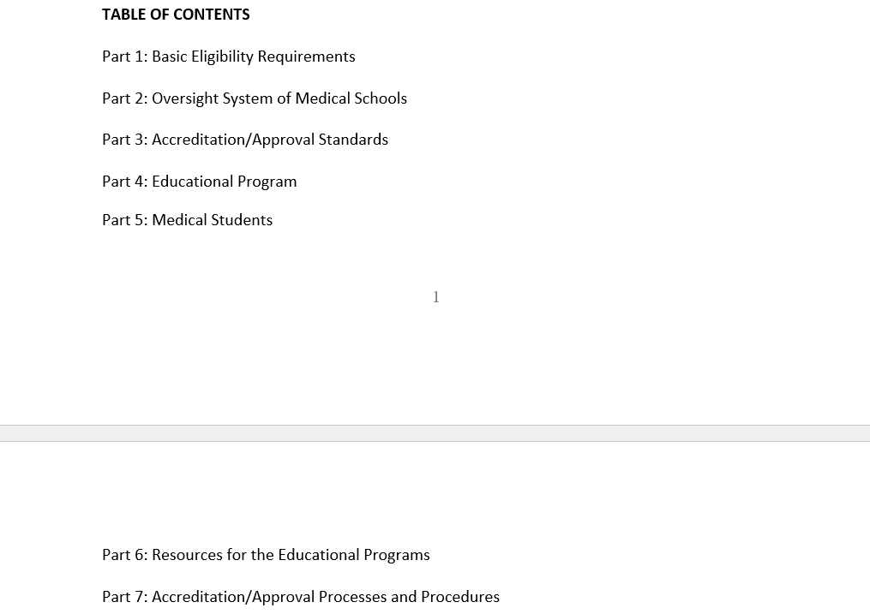
Seven Parts
Notes:
There are now 7 parts followed by general instructions for completing the required narrative response for each individual subsection.

Slide 5
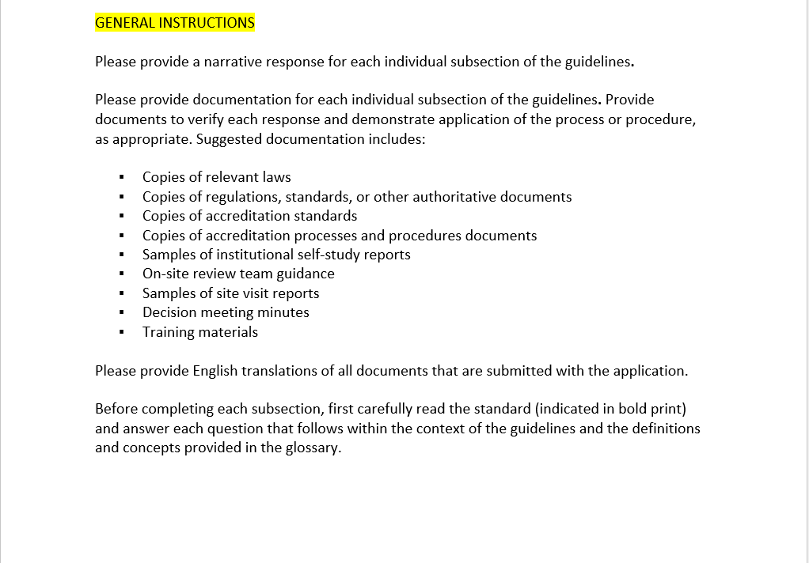
Preparing the Application

Slide 6
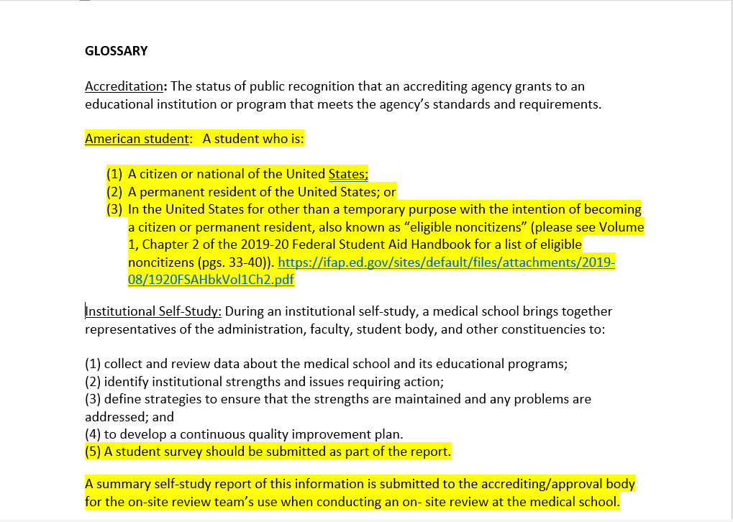
Revised Glossary
Notes:
In the revised glossary, the eligibility requirements for “American student” has been added to this version. In addition, institutions must now submit a student survey as part of their determination report and will be reviewed during the on-site review.

Slide 7
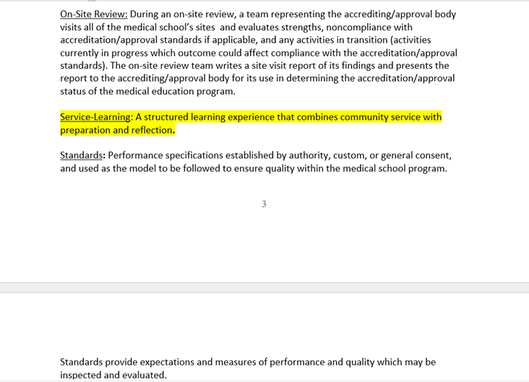
Notes:
The definition of “service learning” has been added to this version of the guidelines.

Slide 8
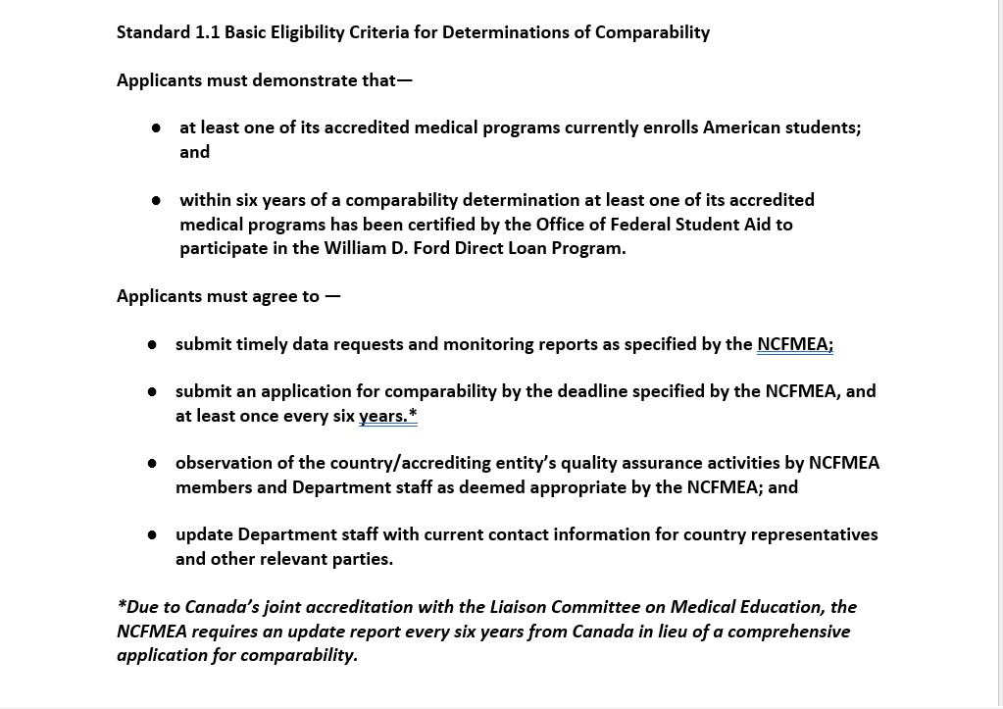
Basic Eligibility Requirements, Pt. 1
Notes:
The Basic Eligibility Requirements section notes what applicants must demonstrate and agree to in order to qualify for comparability. Countries must meet these eligibility requirements during each application period.

Slide 9
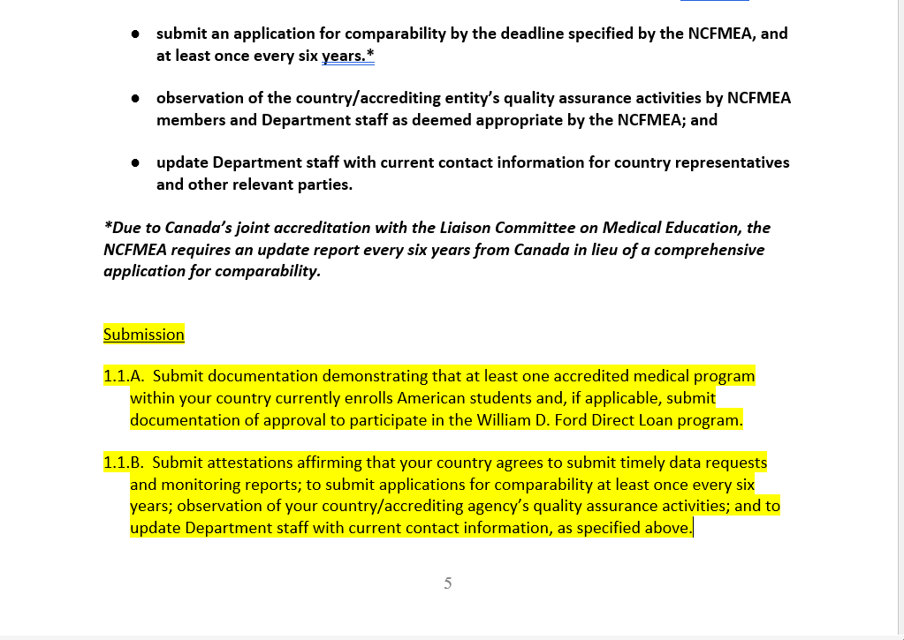
Basic Eligibility Requirements, Pt. 1 Continued
Notes:
The Basic Eligibility Requirements section has been expanded to include additional guidance on what documentation and attestations must be included in the report.

Slide 10
Other Notable Sections
Section 5.3 Student Achievement
Section 5.4 Outcomes Data and Student Course Evaluations
Section 7.2 Onsite Review of Clinical Clerkship Sites
Section 7.7 Accrediting/Approval Decisions

Slide 11
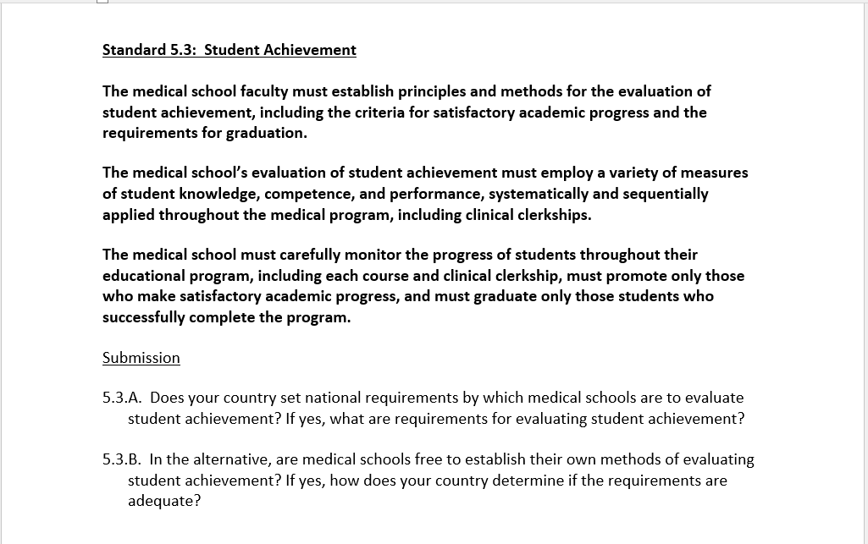
Section 5.3: Student Achievement

Slide 12
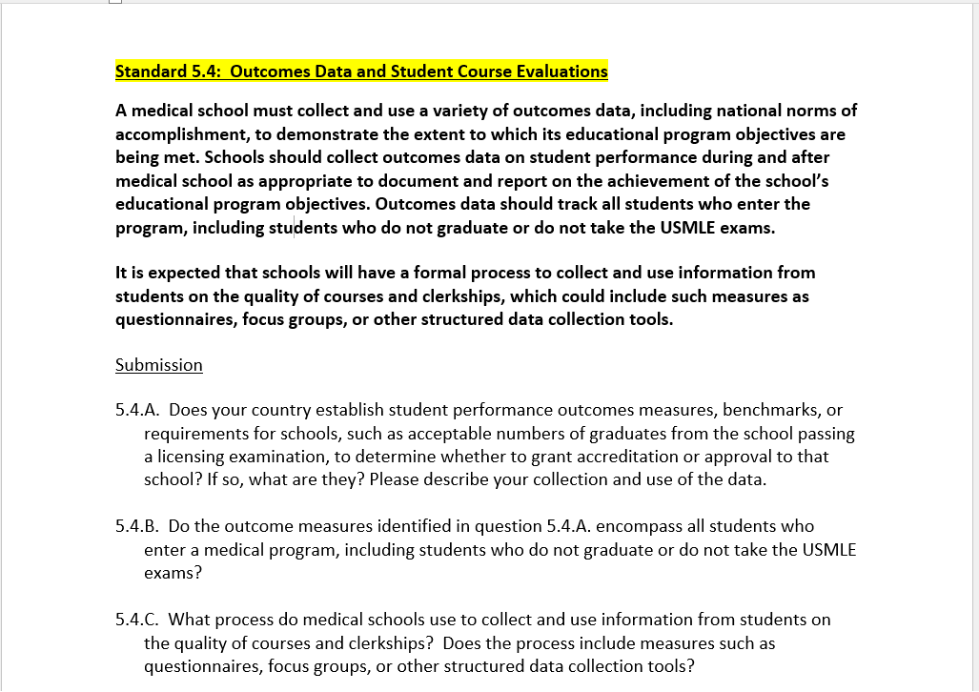
Section 5.4: Outcomes Data and Student Course Evaluation
Notes:
This section has been extracted from section 5.3 to emphasize the use of outcomes data on students’ courses and clerkships and to clarify what information must be submitted in the report.

Slide 13
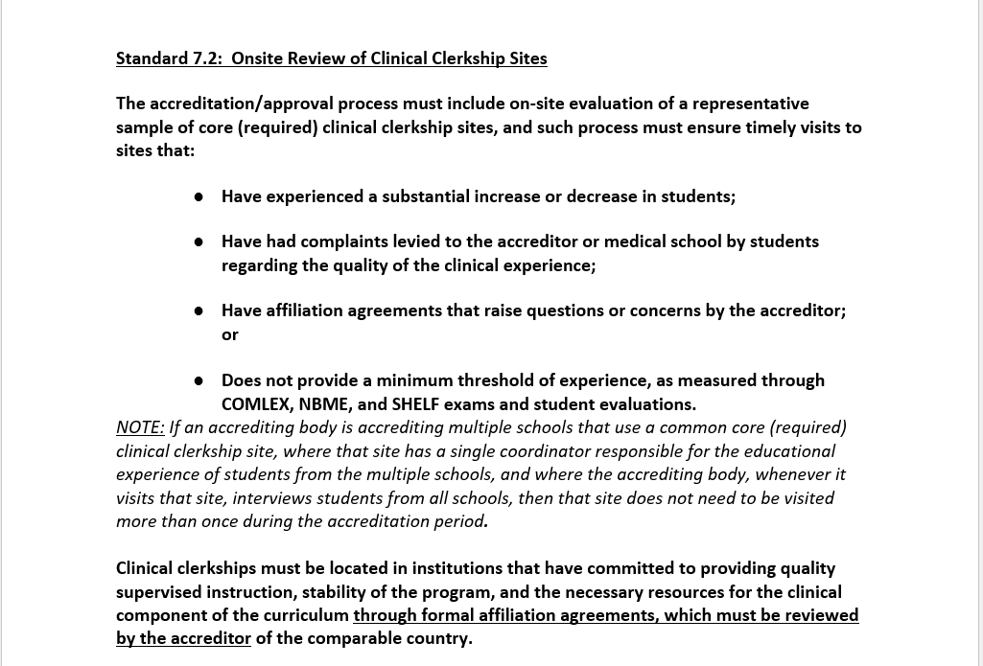
Section 7.2: Onsite Review of Clinical Clerkship Sites

Slide 14
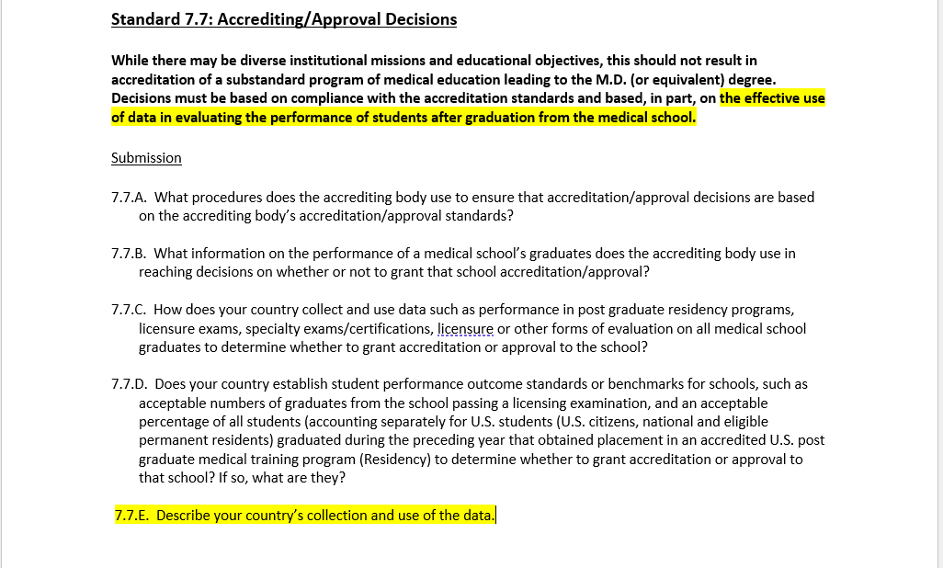
Section 7.7: Accrediting/Approval Decisions

Slide 15
https://sites.ed.gov/ncfmea/
Contact:
George Alan Smith, Ed.D.
Executive Director
National Advisory Committee on Institutional Quality and Integrity, NACIQI
National Committee on Foreign Medical Education and Accreditation, NCFMEA
Office of Postsecondary Education (OPE)
George.Alan.Smith@ed.gov
Monica Freeman
Management and Program Analyst
Office of Postsecondary Education (OPE)
Monica.Freeman@ed.gov

